Slide 1
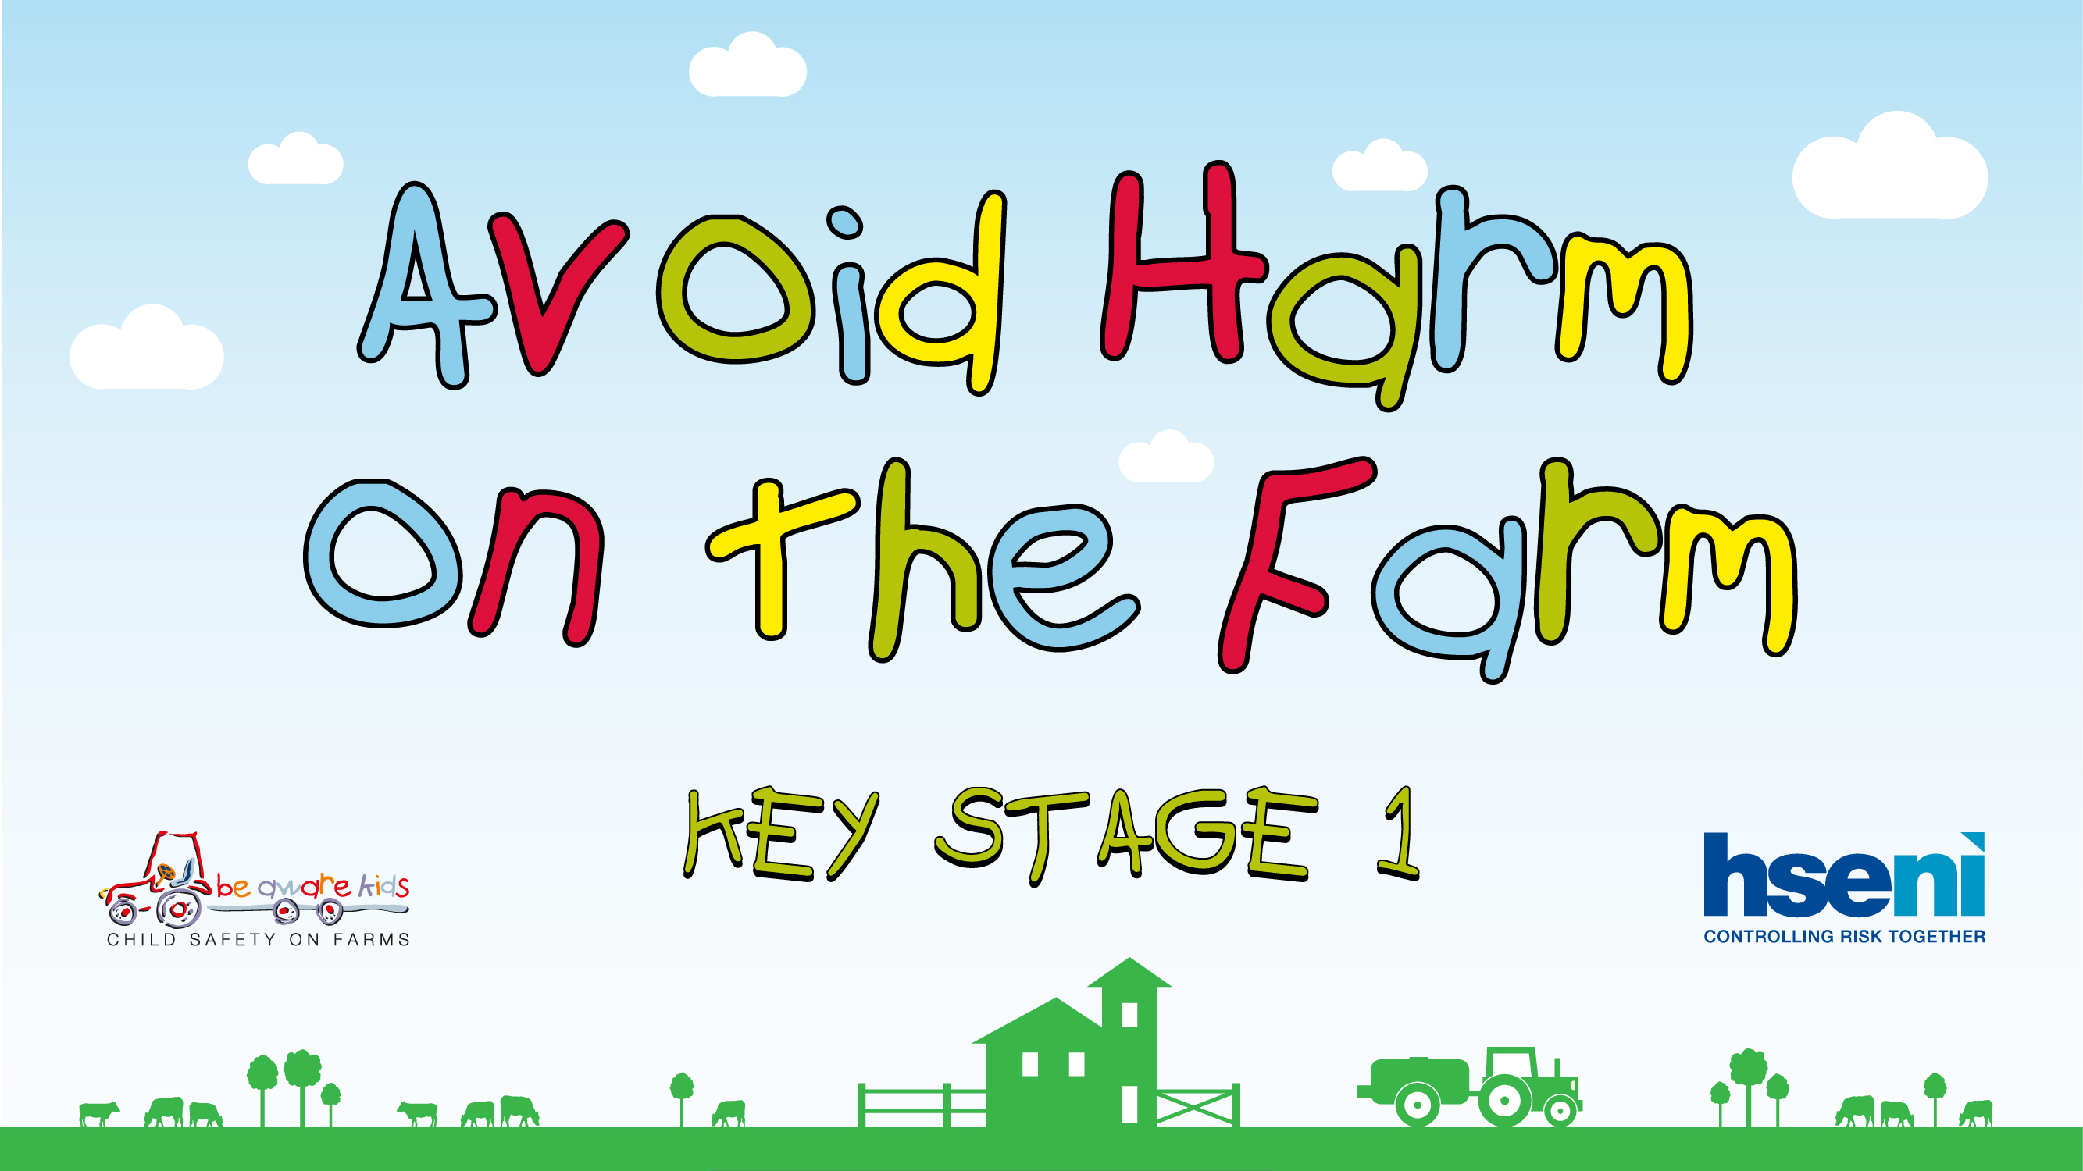
Notes:
Introduction
Good morning boys and girls, I’m xxxxx and today we’re going to talk about farms.
Does anybody here live on a farm?
Farms can be exciting places, but they can also be dangerous.
Who knows what it means when something is ‘dangerous’?
Yes that’s right - it’s something that could harm you.
And If I told you something is ‘safe’ what does that mean?
That’s great, so we all know the difference between ‘dangerous’ and ‘safe’.
Well, we’re going to look at some pictures together and I want you to help me decide whether they are dangerous or safe. So will you help me? If you think they look safe put your thumbs up and if you think they look dangerous put your thumbs down.
Great - here’s the first one…

Slide 2
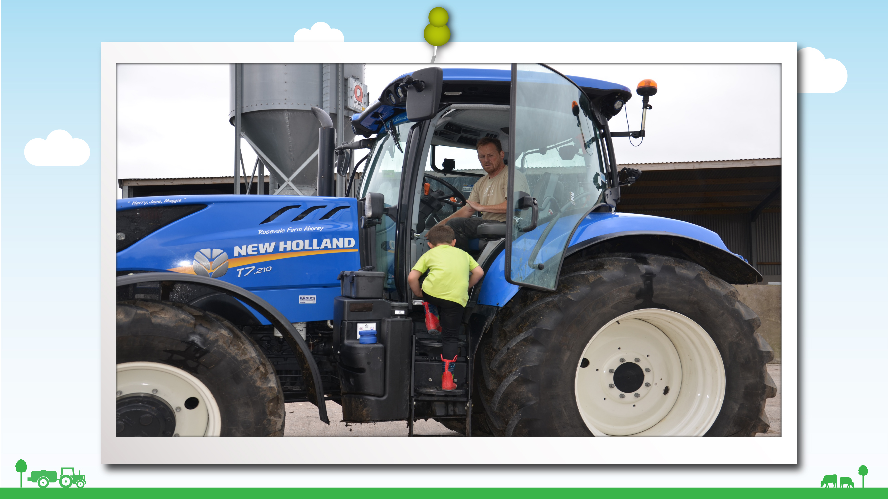

Notes:
Tractors
What do you see in this picture?
Put your hand up if you think it would be safe to play on a tractor?
Put your hand up if you think it would be dangerous to play on a tractor?
What do you think could happen to you if you were playing on a tractor like this boy?
That’s right – you could fall out and get badly hurt.
So if you see a tractor on the farm what would you do to stay safe?
That’s right – Stay away.
That’s great, so we do all know now that it’s dangerous to play or climb or ride on tractors or on any other machinery that you see on the farm?

Slide 3
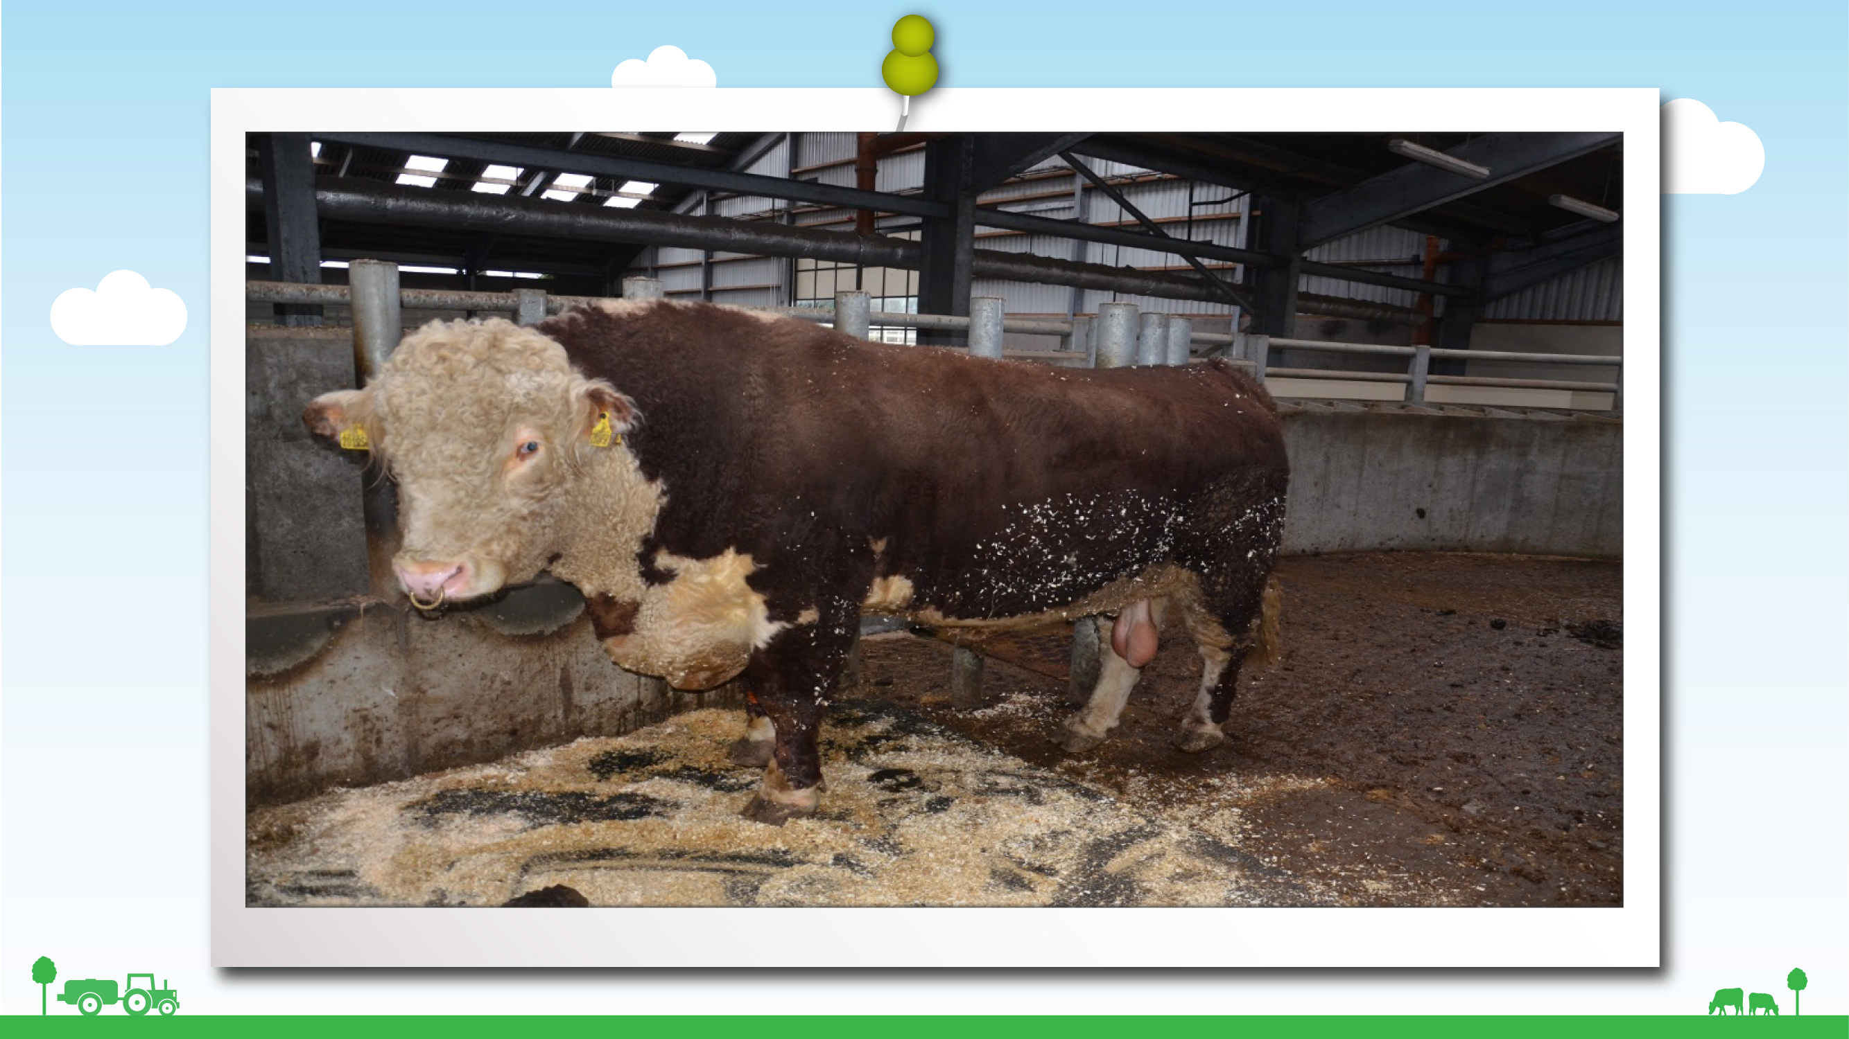
Notes:
Animals
Now, does anyone know what animal this is?
Yes, that’s right it’s a bull.
Put your hand up if you think a bull is safe.
Put your hand up if you think a bull is dangerous.
That’s right – a bull is dangerous.
What do you think a bull would do if you went too near?
Yes, that’s right – the bull might charge at you and knock you down.

Slide 4
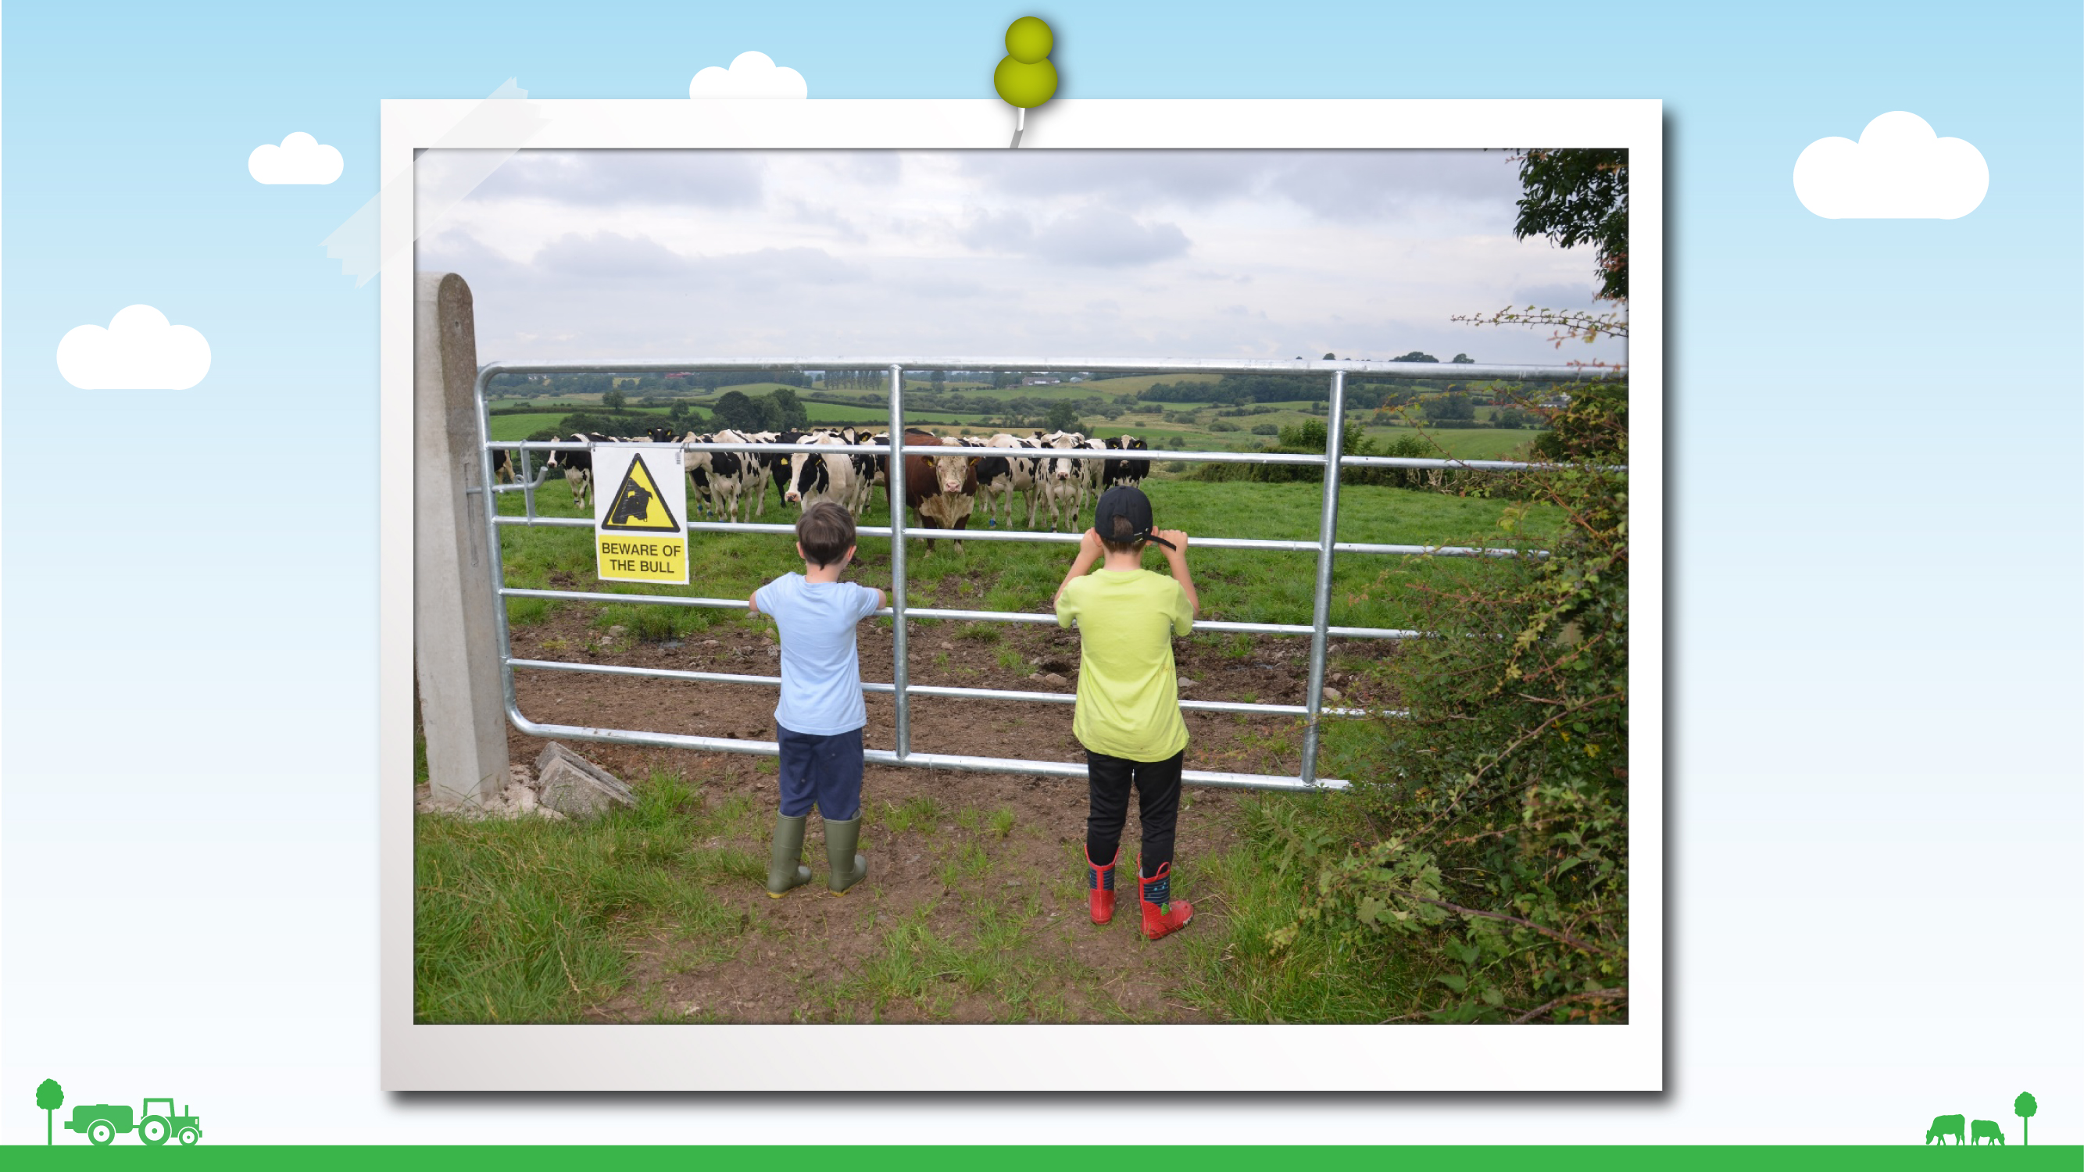

Notes:
Animals cont’d
If you saw a bull in a field, what should you do to keep safe?
Yes, that’s right – Stay away - behind a gate or the fence.
Just like these children in this picture.

Slide 5
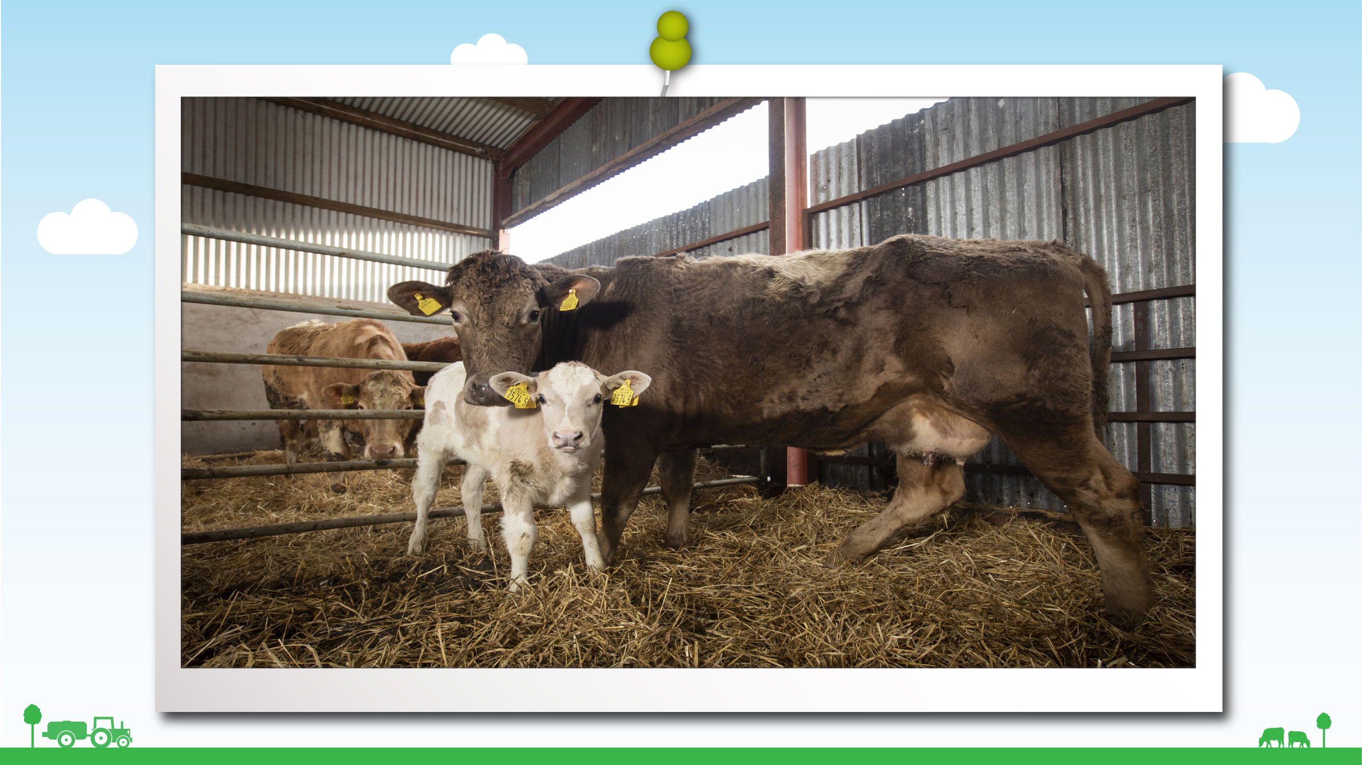
Notes:
Animals contd.
What do you see in this picture? (Cow and calf)
Cows can be dangerous too, especially when they have their calf with them.
Why would they be dangerous when they have a calf? What are they trying to do?
So can anybody tell me how they would stay safe if they saw a cow and a calf in a field?
That’s right - Stay away – keep on the other side of the fence, closed gate etc.
That’s great, so we all know now to stay away from animals like bulls and cows because they could be……dangerous.

Slide 6
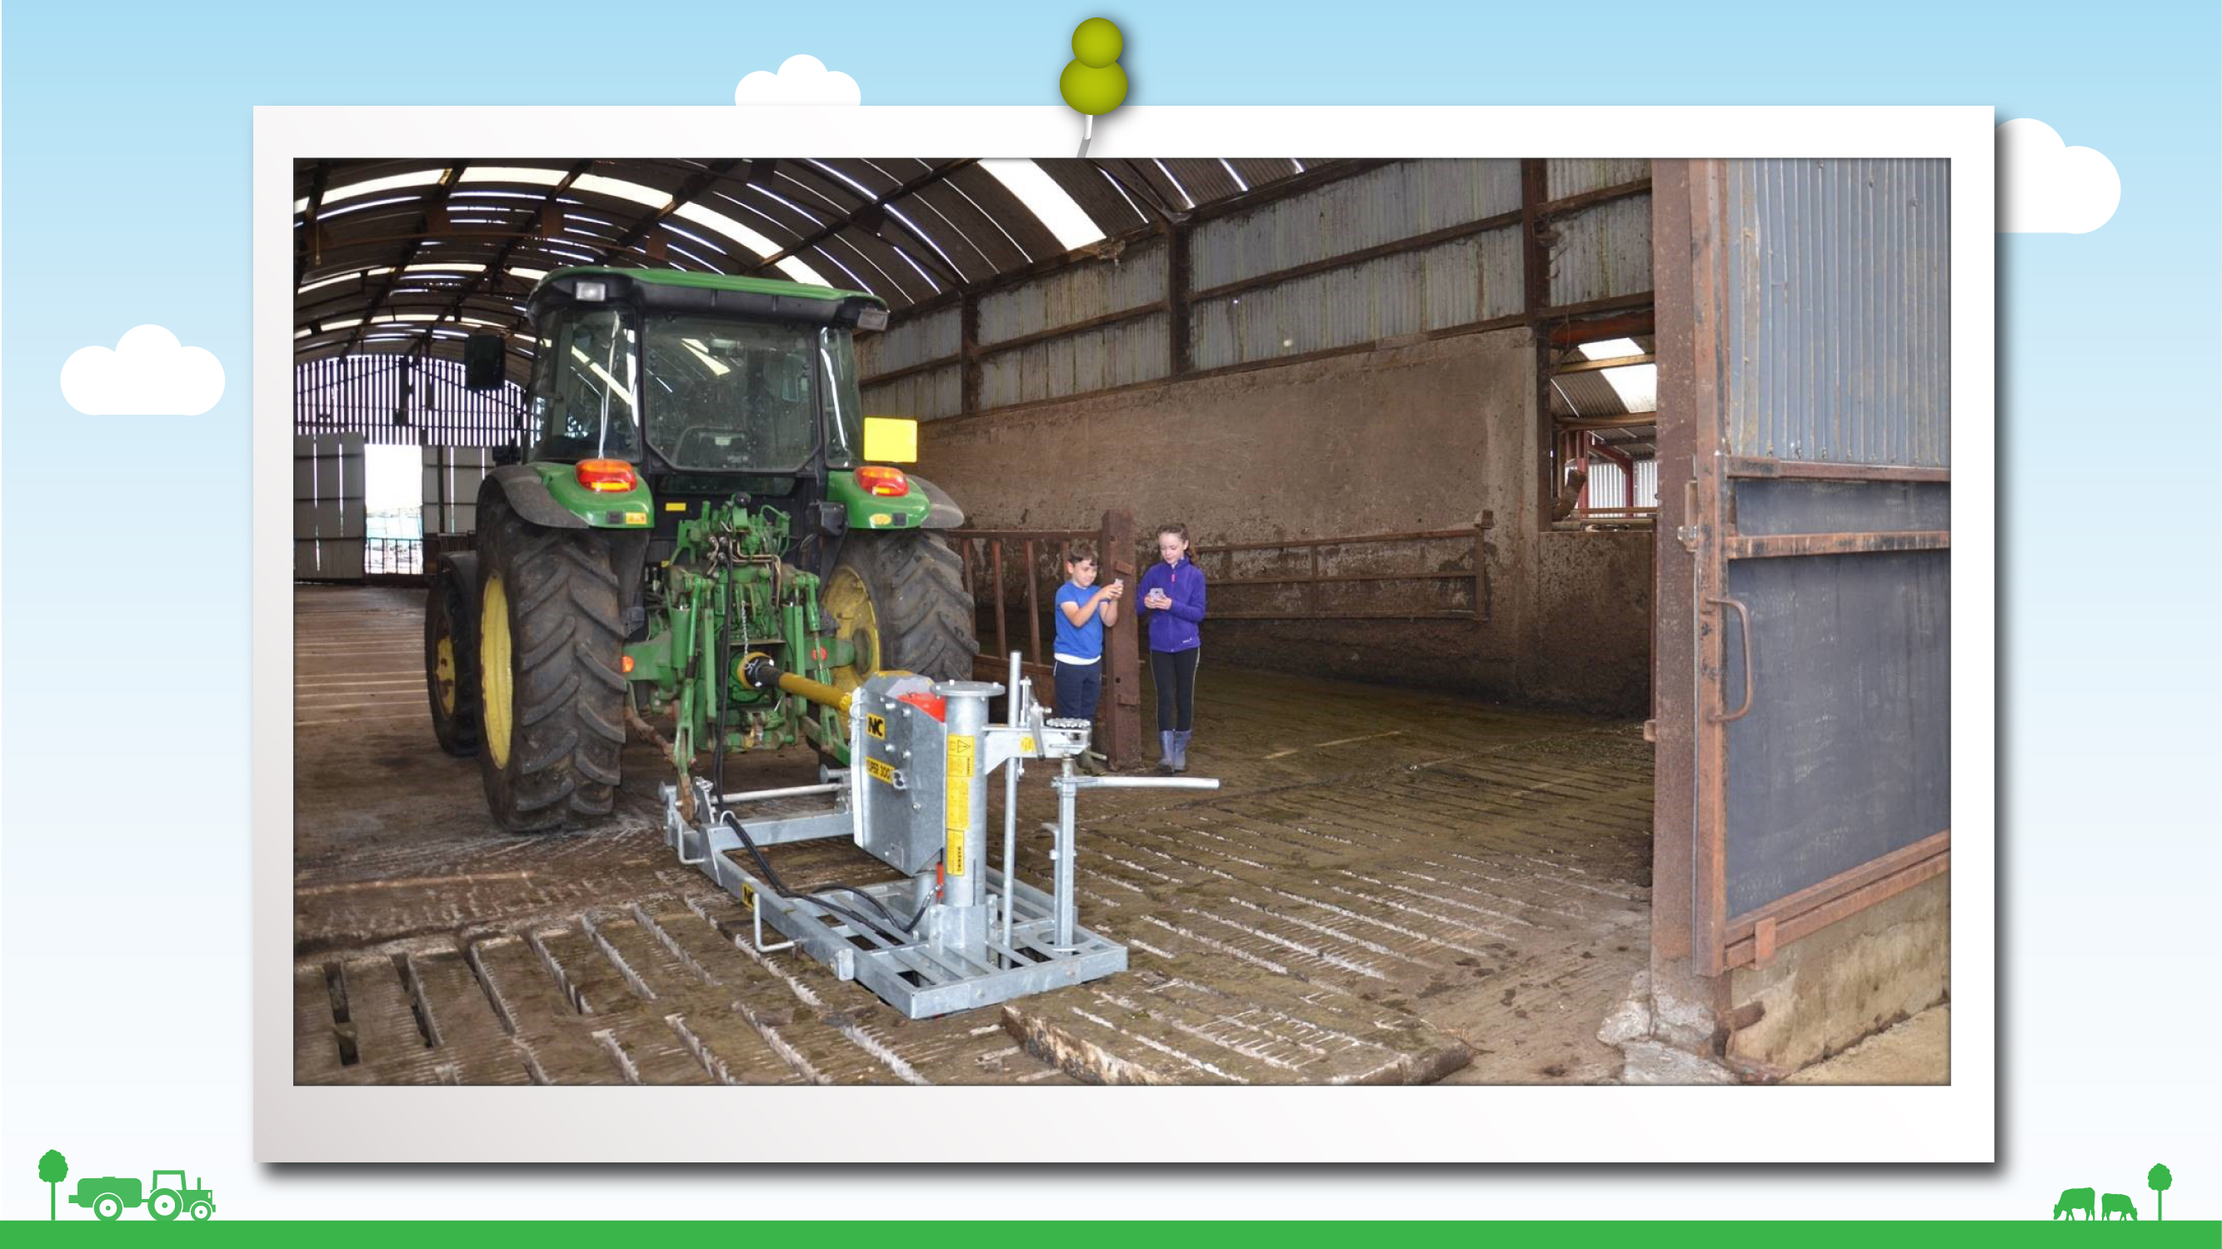
Notes:
Slurry
Does anybody know what is happening in this photo?
Yes that’s right the slurry is being mixed.
Who knows what slurry is?
Well it’s the animal’s poos and pees all mixed together, and the farmer stores it either in tanks under the animal sheds or sometimes in open areas above ground in big tanks.
Slurry is horrible stuff – you can’t swim through it and it gives off dangerous gas that can knock you out, and slurry tanks are often very deep, so if you were to fall in you probably wouldn’t be able to get out again and he could drown.
Do you think the children in the photo are safe beside the tractor as it mixes?
Do you think they realise? Are they too busy on their mobile phones?
So if you see an area like this on the farm what will you do to stay safe? (keep away)
If you see adults working with slurry, especially mixing slurry with a pump, stay well away as slurry gives off gases when its mixed which can make you very sick and even kill you. Don’t go inside a shed where slurry is being mixed.

Slide 7
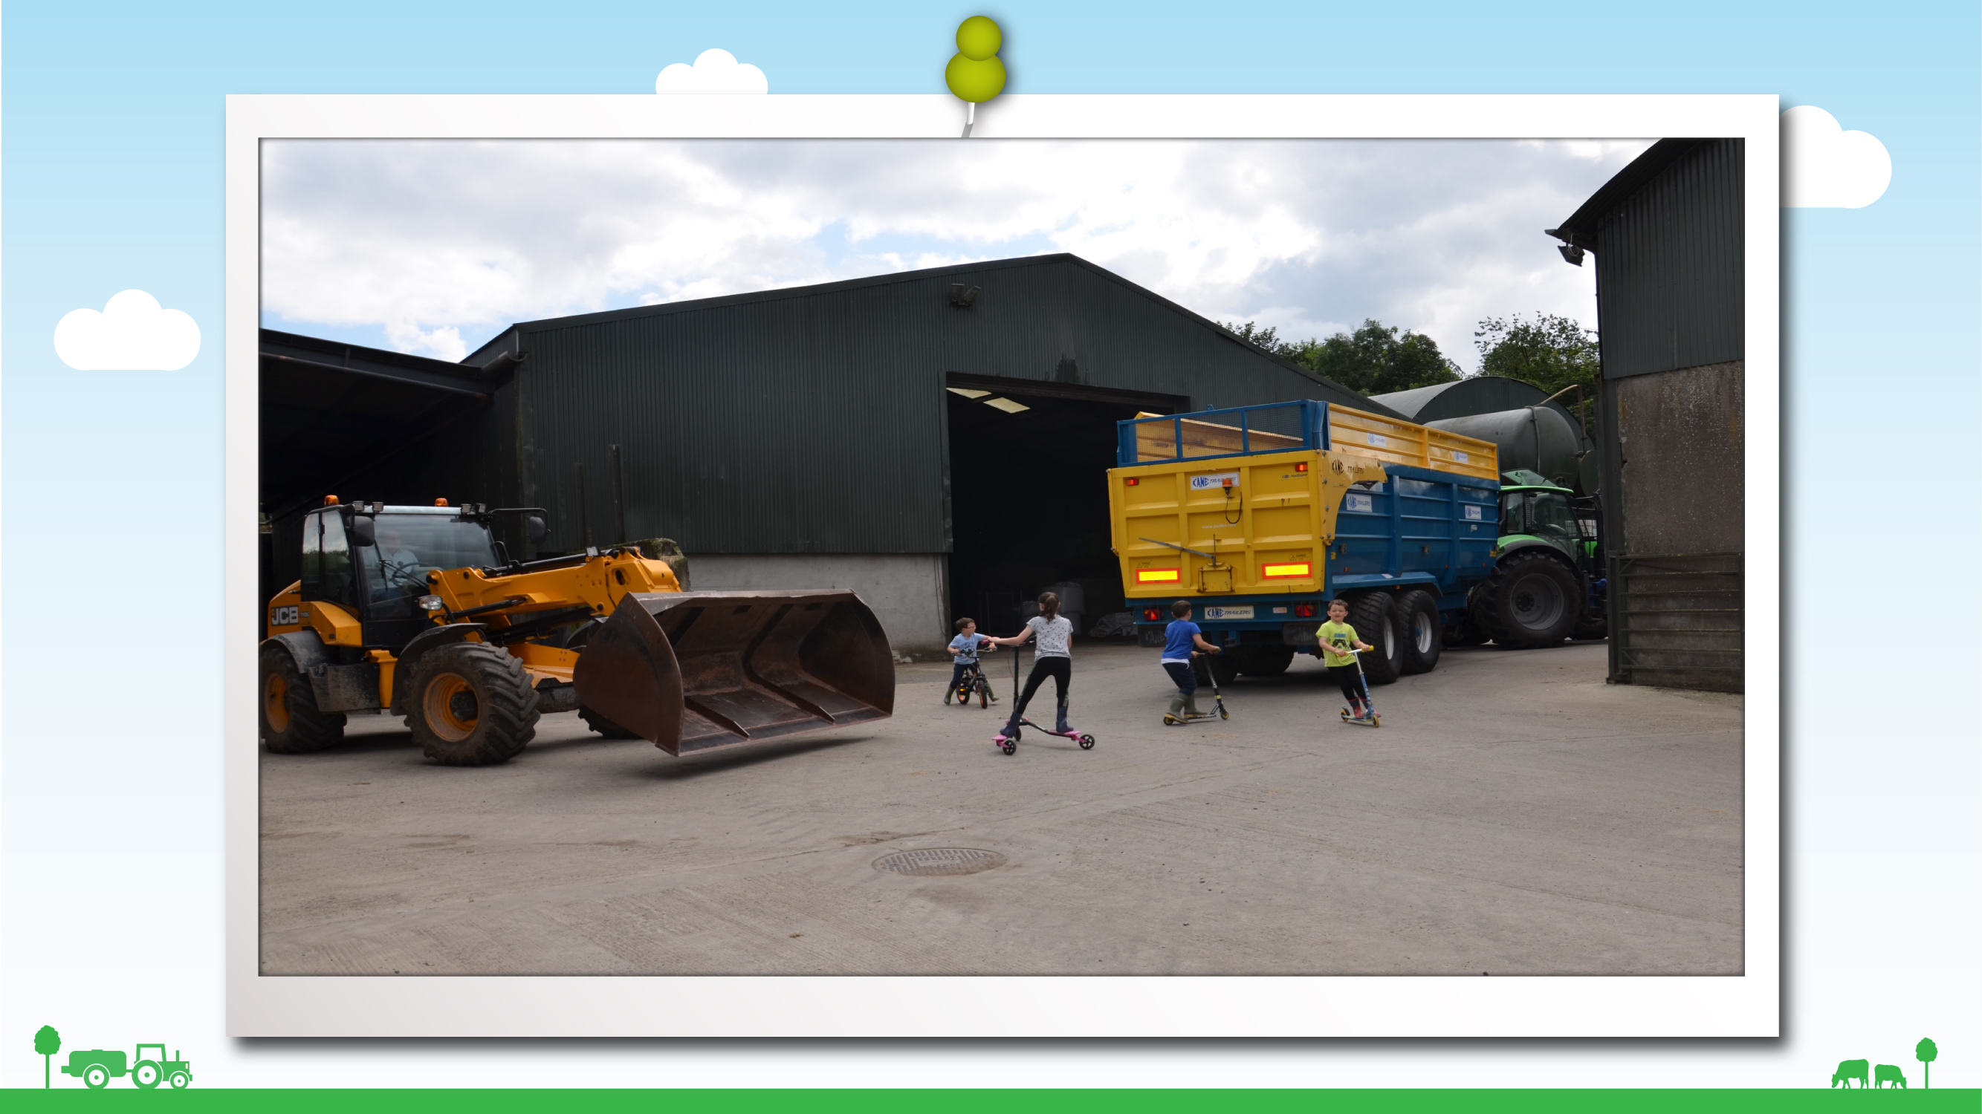
Notes:
Busy farmyard
Here is a picture of children playing on scooters in the farmyard.
Put your thumbs up if you think this is a safe place to play and put your thumbs down if you think it’s a dangerous place to play.
That’s right – it is dangerous.
What could happen to these children?
That’s right – they could get knocked down by the machinery.

Slide 8
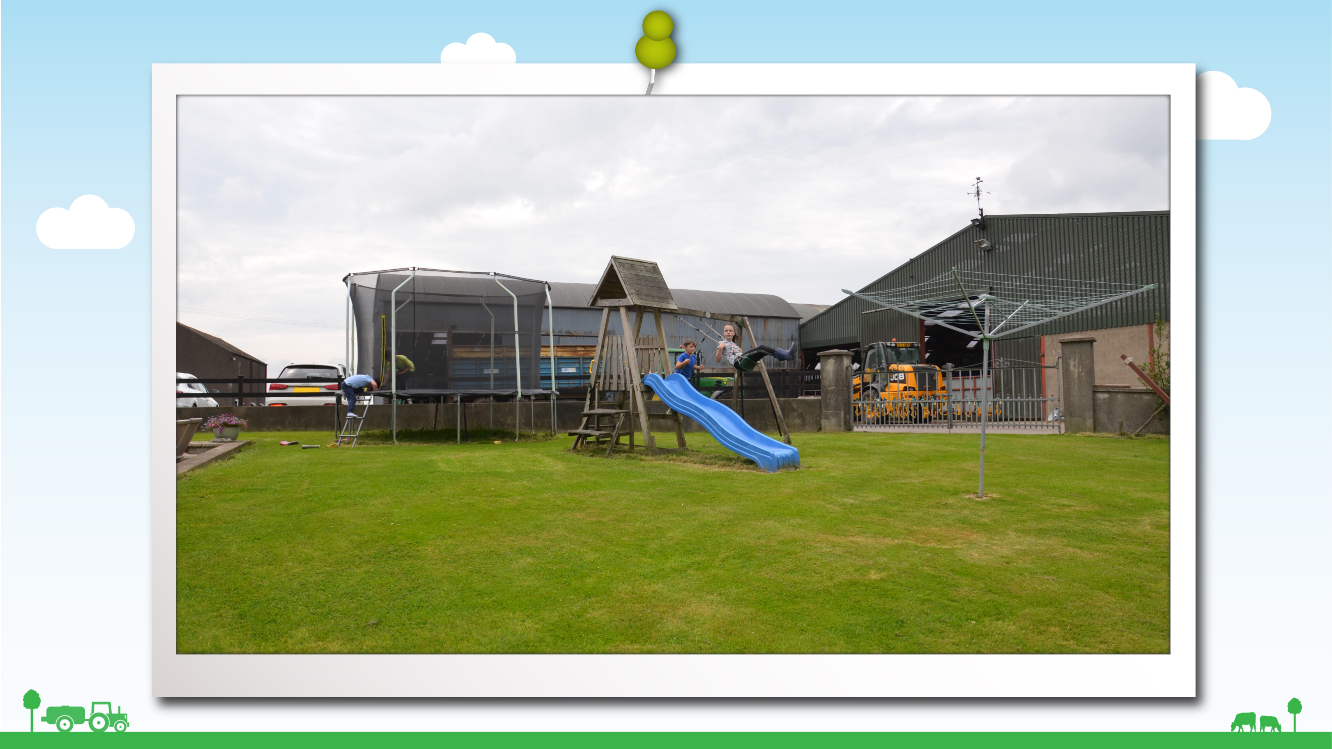
Notes:
Safe play area
Somewhere like this - a garden or play area where there are no dangerous things to harm you and your friends is a safe place to play.

Slide 9
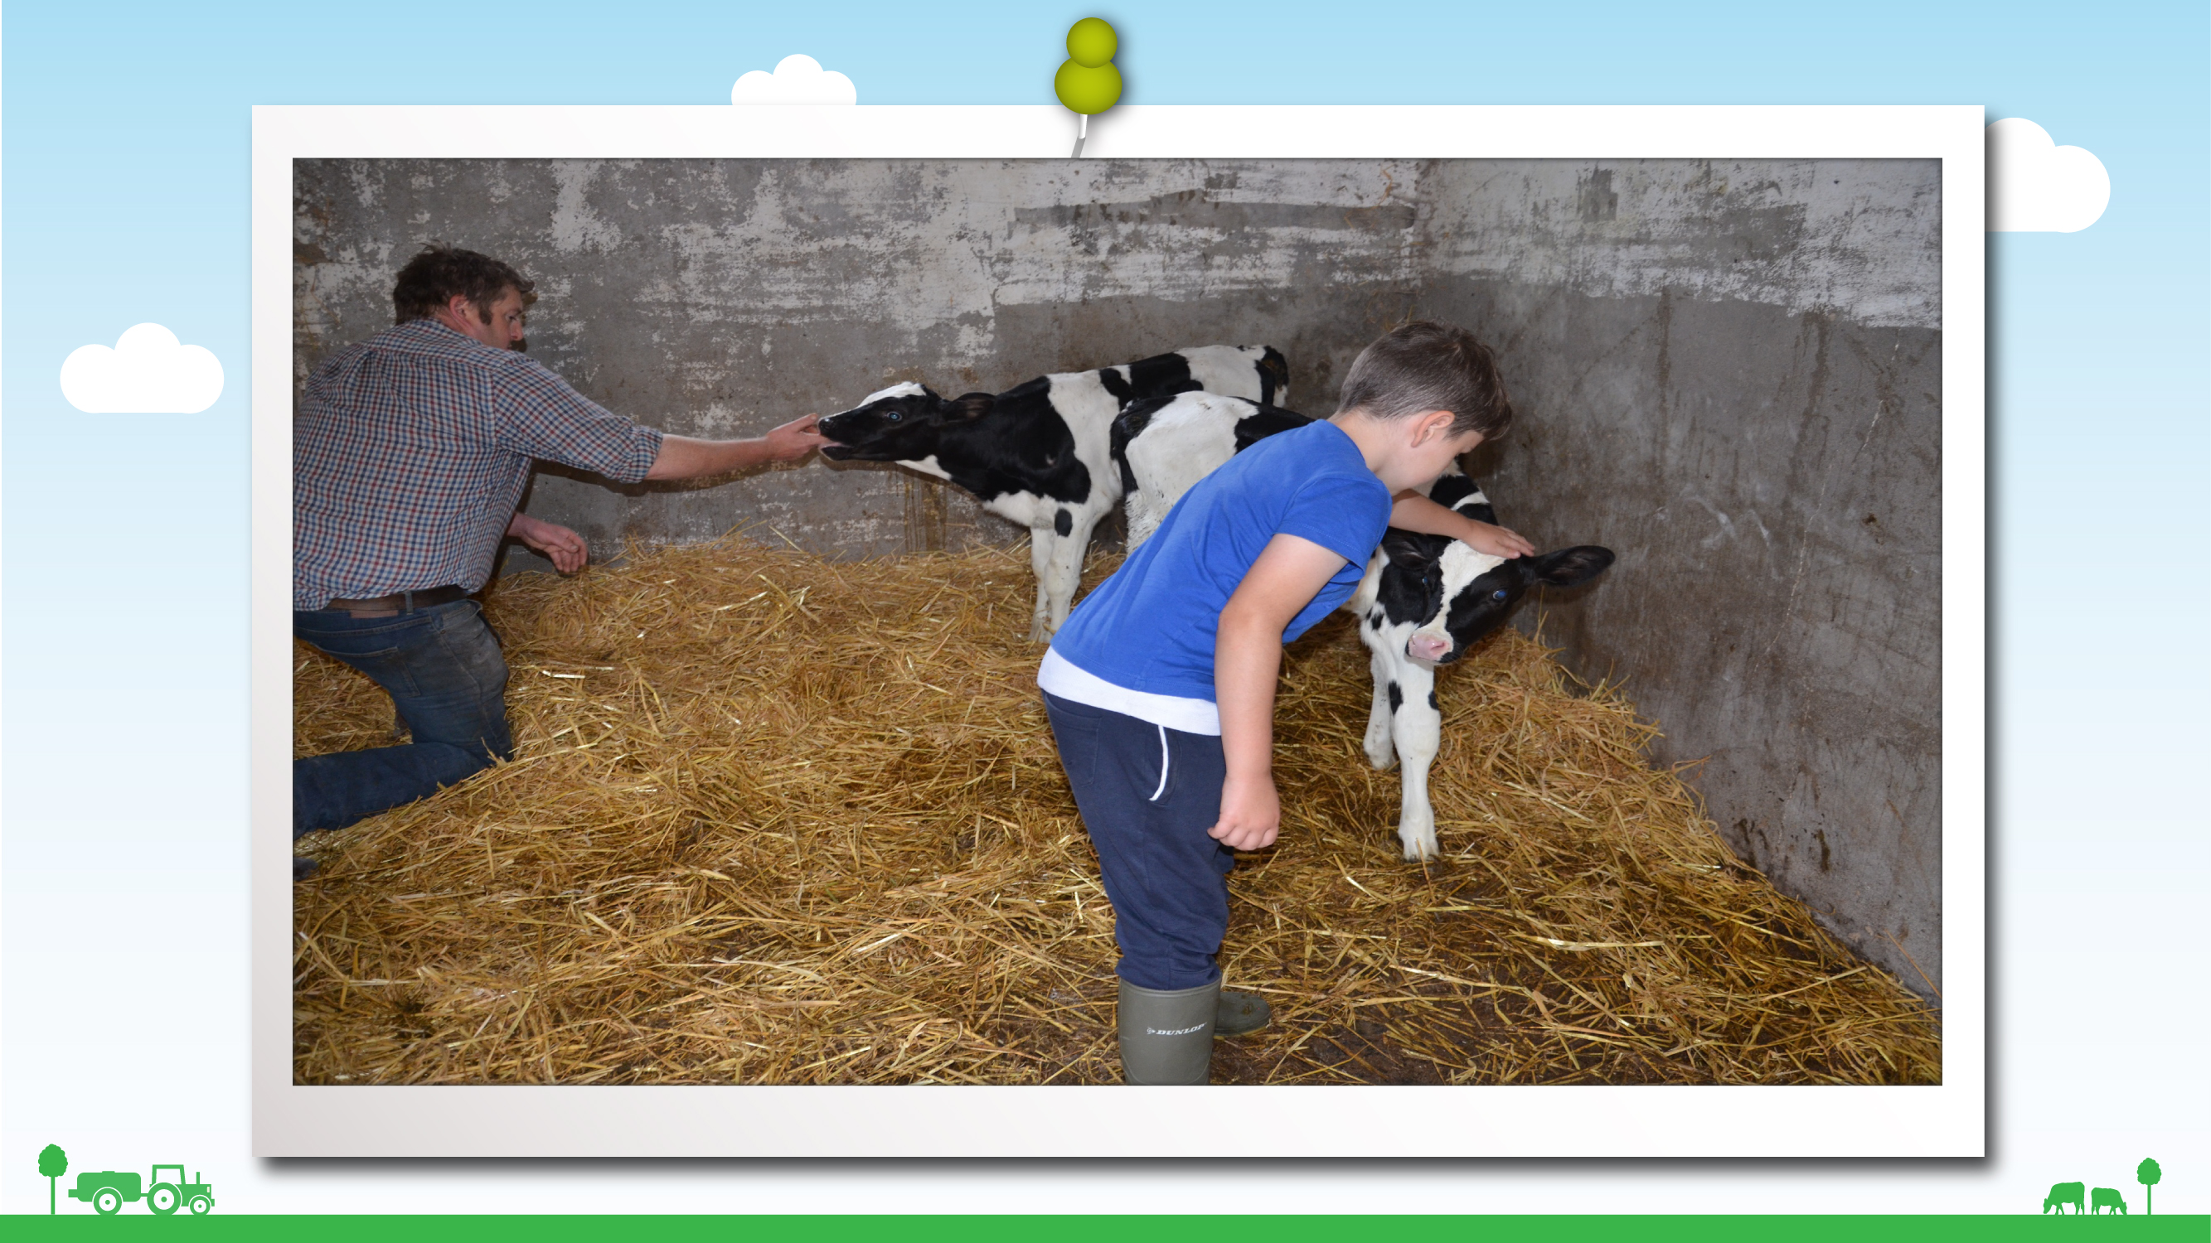
Notes:
Things you can do
There can be some fun things you can do on the farm if you have an adult with you.
This little boy in the photo has been allowed to pet the calf when he is being supervised by his daddy.

Slide 10
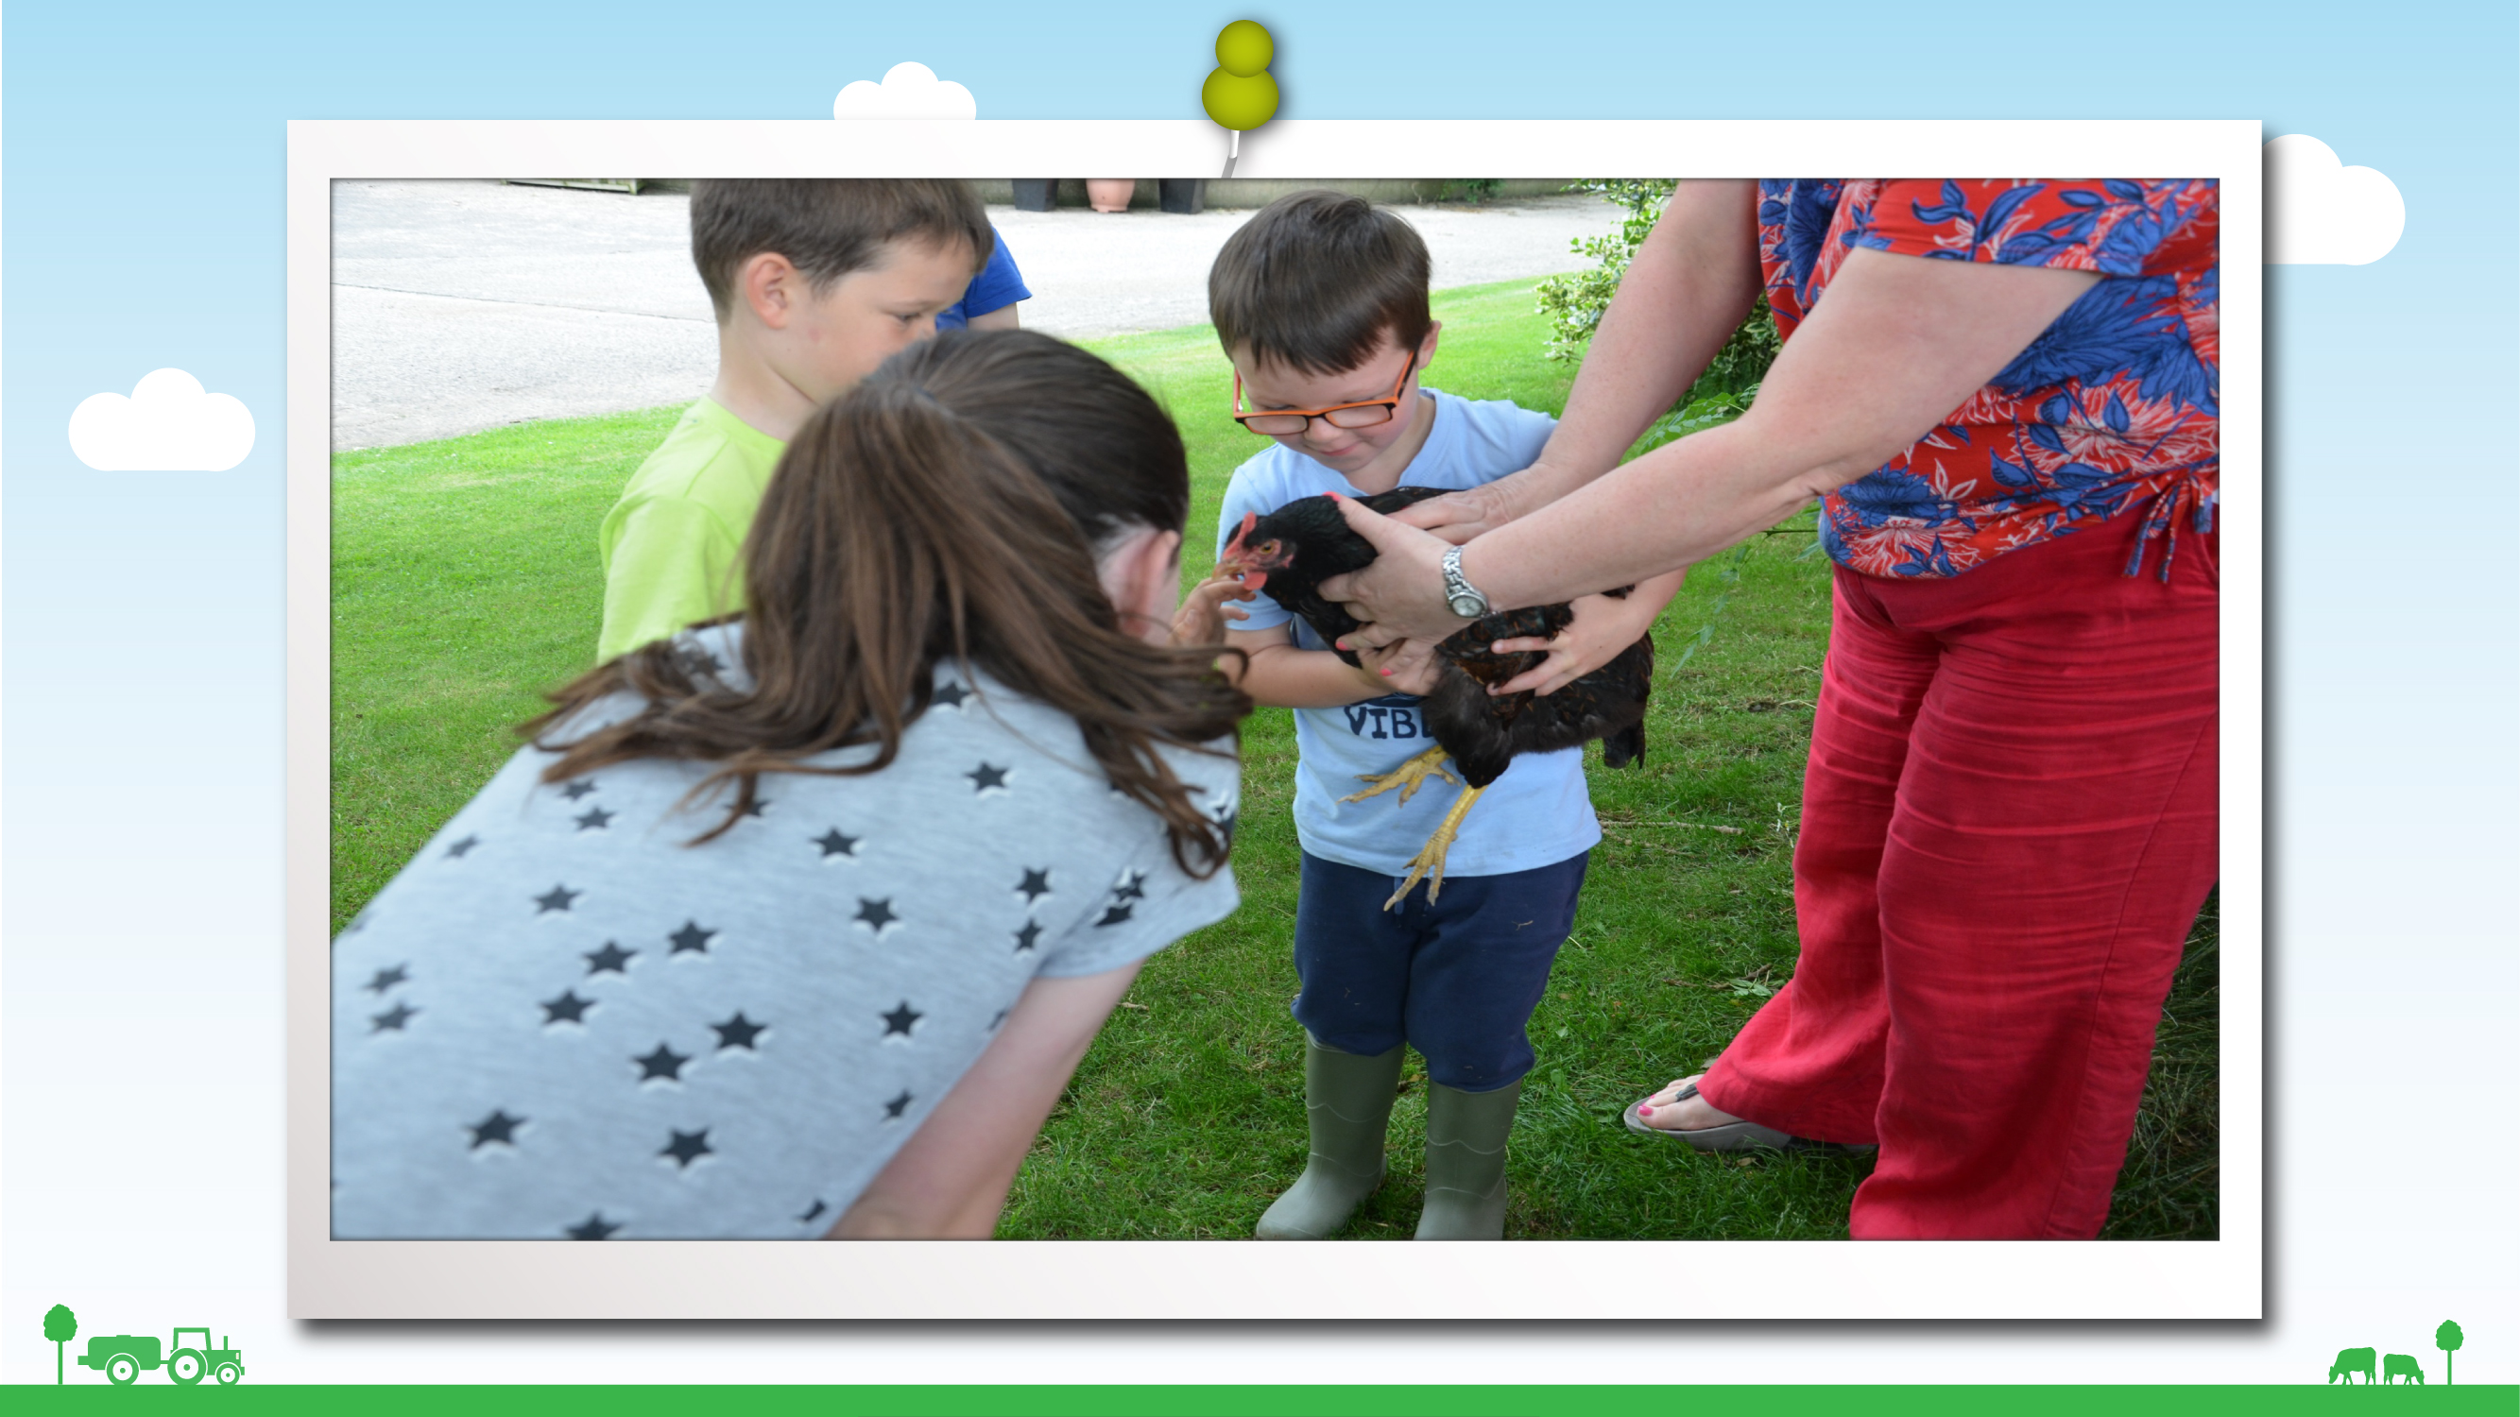

Slide 11
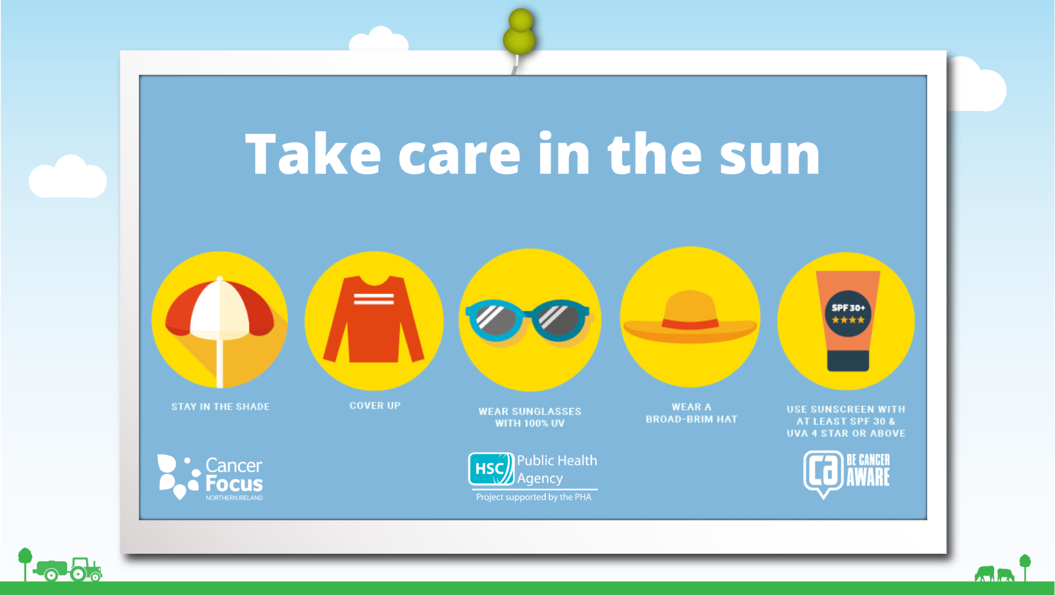
Notes:
It is great fun to play outdoors when the weather is good but what should the boys and girls be careful to do when playing in the sun?
Yes, you should always
Wear a T-shirt
Wear a sun hat
Play in the shade between 11am – 3pm
Apply a high protection sunscreen to exposed skin. It is recommended to use a minimum of SPF 30 but to encourage SPF 50

Slide 12
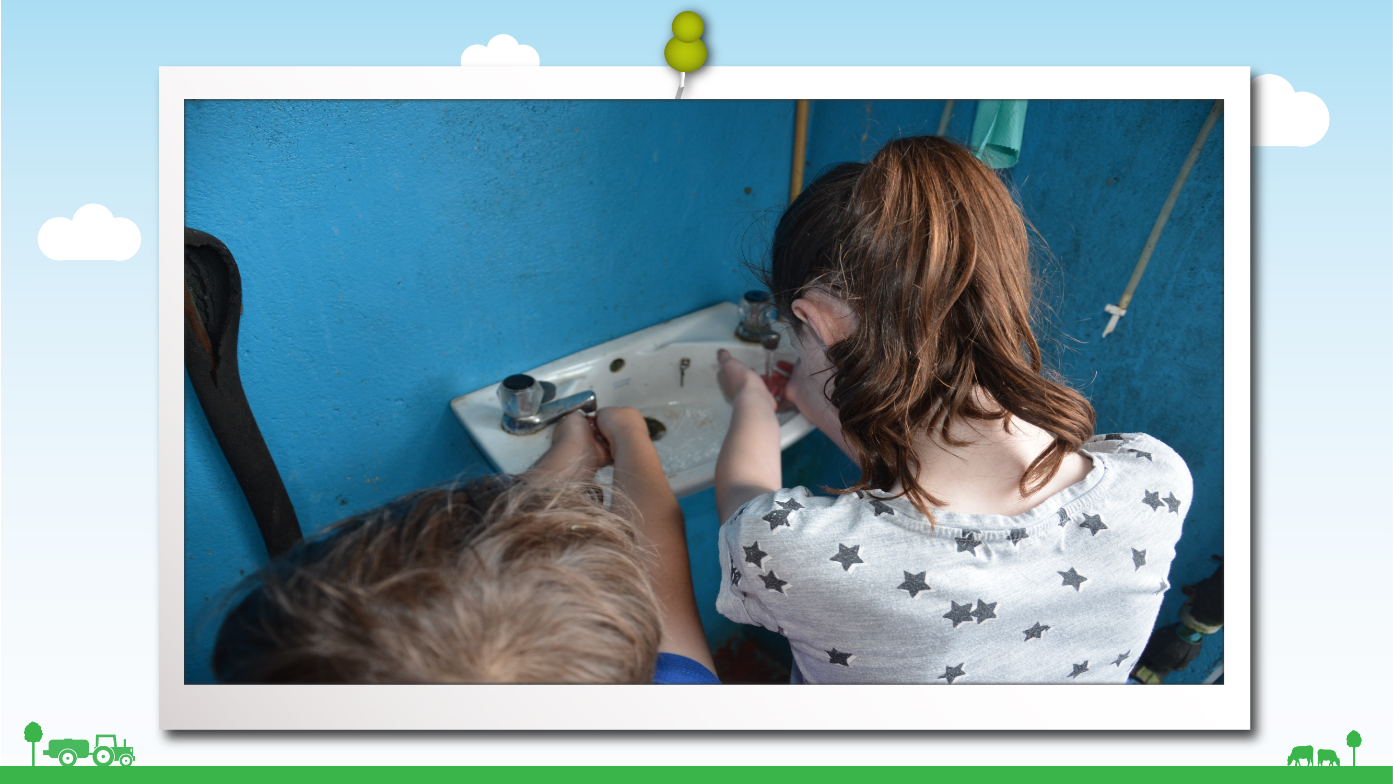
Notes:
Hygiene
It can be great fun if you’re allowed to touch the animals but do you know that there are certain diseases that can spread from animals to people? These diseases can make you very sick and you can catch them if you’ve been touching the animals or touching things around the farm where the animals have been.
So what do you think this boy should do as soon as he comes back into the house from the farm and before eating?
That’s right - wash his hands.
And you should never eat food or drink around the farmyard for the same reason.
So will you remember, if you have been out on the farm, to always wash your hands as soon as you can afterwards. Especially if you’ve been petting any animals like lambs.

Slide 13
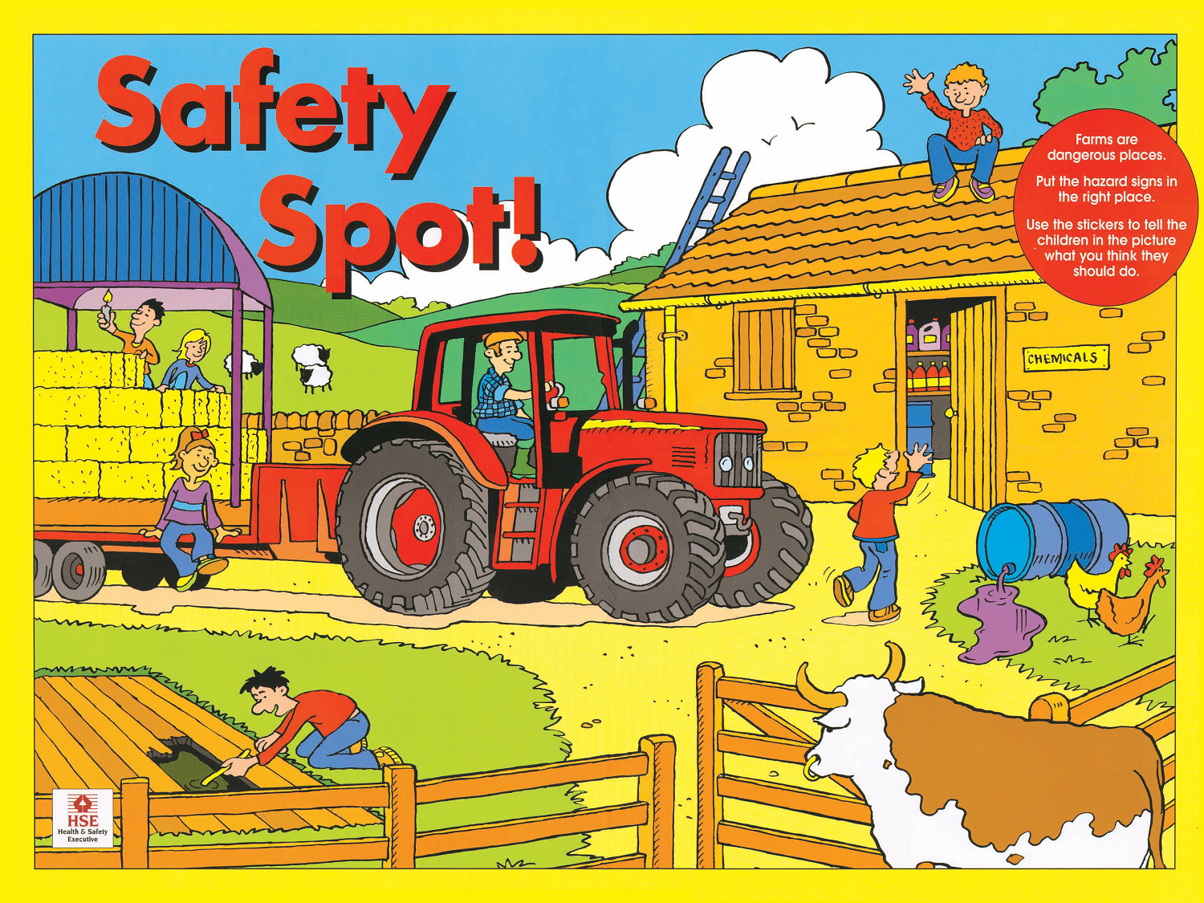

Slide 14
