Slide 1
Notes:
Introduction
Good morning boys and girls, I’m xxxxx and today we’re going to talk about farms.
Does anybody here live on a farm?
Does anybody here have a granny or granda that live on a farm?
Farms can be exciting places, but they can also be dangerous.
I’m going to tell you about some of the most dangerous things you will find on farms that have caused children in Northern Ireland to be seriously injured and in some cases have died. I’m going to ask you if a picture looks safe or dangerous and if you think they look safe put your thumbs up and if you think they look dangerous put your thumbs down.
It’s important that you know what these are so that you will know how to stay safe and protect yourself from harm.
What do you think are some of the dangers that are found on farms?

Slide 2
Notes:
Riding on tractors
First I’m going to talk about tractors as they are one of the most dangerous thing on the farm.
What do you see in this photo? ( a girl getting into a tractor)
How old do you think this girl is? ( 10 or 11)
How old do you think you have to be before you’re allowed to get into a tractor as a passenger? (13 years old).
It’s against the law for children under 13 to be in a tractor even as a passenger, because so many children fall out of tractors every year.
This type of accident often happens in the same way – the child gets into the tractor with the driver, and the driver thinks they are safe, but sometimes the child will hold onto the door of the tractor to steady themselves and sometimes they pull on the handle of the door by mistake.
Most tractor now have a passenger seat but this does not mean that it is ok for anyone under 13 to get into them.
What do you think happens when they pull on the door handle? (the door opens)
Driving tractors
Did you know that when you turn 13 you’re actually allowed to ride a tractor on a farm – but what do you think you have to do first? (attend a training course at one of the agricultural colleges like Greenmount, Loughry or Enniskillen and learn how to properly drive a tractor).

Slide 3
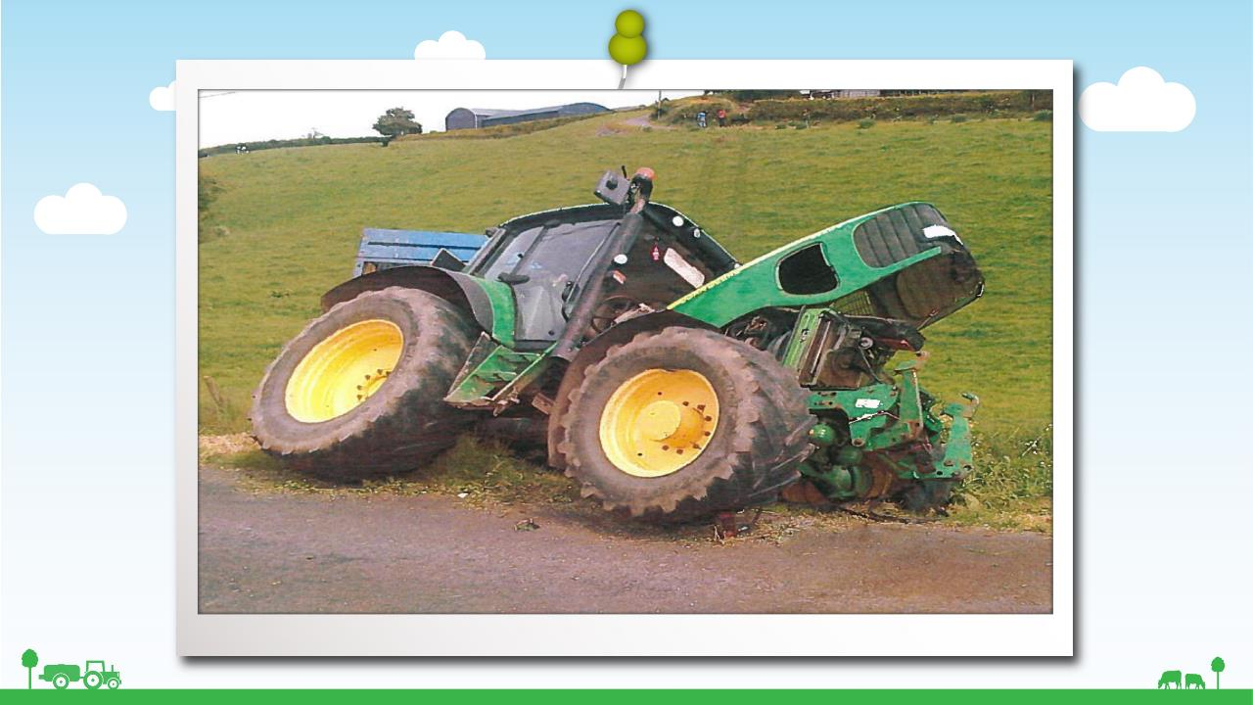
Notes:
Message for key stage 2:
This was a young driver who hadn’t learnt how to drive a tractor properly. He lost control of the tractor as it was going down the field and it overturned. Can you see the tracks down the field where the tractor went?
This accident might not have happened if the driver had been on a training course and had learnt how to drive safely.
So will you remember when you turn 13 - if you want to drive a tractor to get your mum or dad to put your name down for one of the driver training courses at Greenmount, Loughry or Enniskillen college?

Slide 4
Notes:
Quad bikes
A lot of farms now have quad bikes and just like tractors they can be dangerous too if you don’t know what you are doing.
Do you think the pictures on the left hand side look safe?
This is a quad bike for adults only. You should never be on a quad like this unless you are aged 16 or over because it’s too big, powerful and heavy for you to control. Quad bikes might look easy to ride, but they can flip over very easily and if they land on top of you, you would be seriously injured or killed.
I know some of you may have been on the smaller quad bikes before and if you’re under 16 and are going to be riding a quad bike I want you to remember some things that will keep you safe and which could save your life:
1. Check that you're old enough to ride the quad - look for the age limit sign. If you're not old enough to ride it you wont be able to control it.
2. Before you get on a quad what should you always put on? A safety helmet with the strap fastened.
3. Never get on a quad bike unless you have been shown how to ride it safely and have been told what the controls are for.
4. Never carry passengers on a quad bike. To control and steer properly you need to be able to shift your weight about and if there's a passenger on the back you can't do that. And will you remember never to ride as a passenger yourself even if somebody asks you to get on with them.
5. Don’t make turns at high speed.
6. Always keep both hands on the handlebars when you’re riding.
7. Never ride on public roads or footpaths.

Slide 5
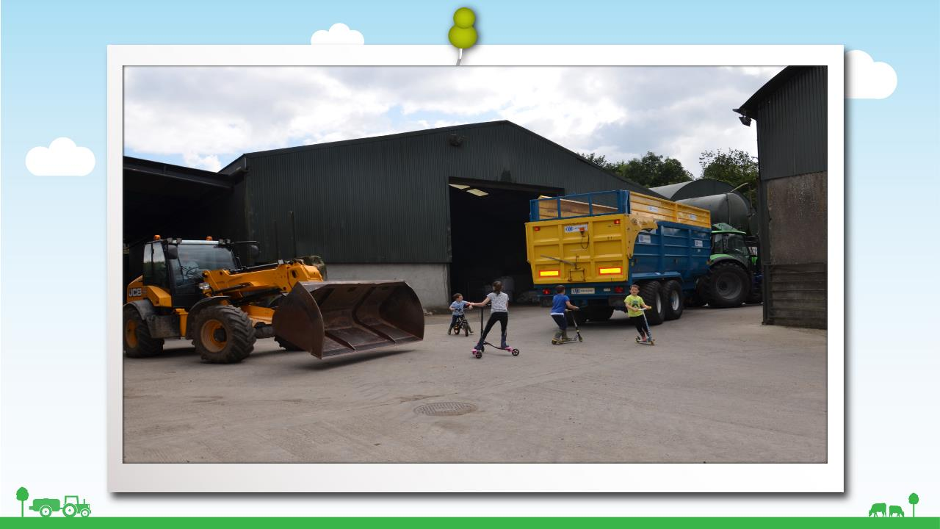
Notes:
Busy farmyard / moving vehicles
The next dangerous thing on the farm – it’s the busy farmyard itself and the vehicles and machinery working there.
What do you see in this photo? (children playing)
Do you think this is a safe place to play? (No)
What is the telehandler/yellow machine doing? (driving forward)
And what is the tractor and trailer doing? (reversing)
Do you think the farmer can see the children? (probably not)
Do you think he could hear them if they shouted ‘STOP’ ? (probably not because the machinery is very loud)
Do you think the children realise they are in danger? (no because they’re having too much fun and not paying attention)
So what could happen to the children? (they could be run over)
Yes, they could be run over and this has happened a lot to children on farms.

Slide 6
Notes:
Busy farmyard / moving vehicles cont
What can you see in this photo? Does it look safe?
Do you think the tractor driver can see the girl running for the ball or the children behind the tanker?
These pictures are telling us that the farmyard isn’t a safe place to play – it’s a busy workplace and if you’re playing in a farmyard and there’s a tractor or some other vehicle coming towards you, don’t think the driver will stop before he gets to you, because he probably hasn’t seen you (and he won’t be expecting to see you) and he won’t hear you shouting.

Slide 7
Notes:
Can you see the children in the photo?
Do you think the driver can see them?
They have ran in front of the telehandler that is driving forward to get their ball.

Slide 8
Notes:
There are so many vehicles that come in and out of a busy farmyard and the drivers are not always thinking that children could be just around the corner and they may not see you or your friends!
Can you see any children in this photo?
Do you think this a safe place to play?
No.

Slide 9
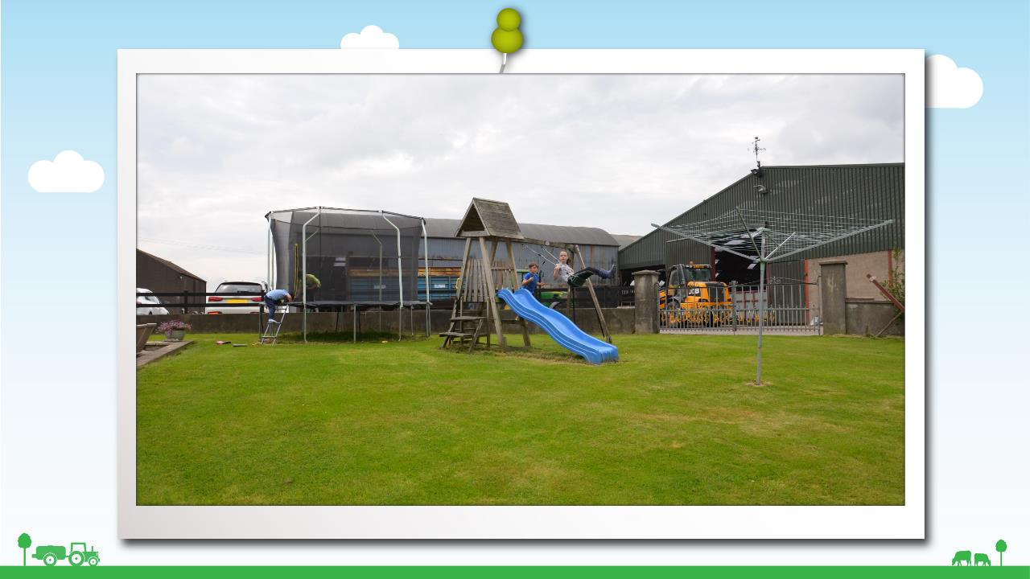
Notes:
Safe play area
We have talked about the farmyard not being a safe place to play, does this look like a safe place to play instead?
A garden or play area where there are no dangerous things to harm you and your friends, that has a fence around it to keep you safe is a great place to play.

Slide 10
Notes:
Animals
Now what type of animal do you think this is?
Yes that’s right it’s a bull.
Is a bull a friendly animal?

Slide 11
Notes:
Animals cont
If you saw a bull in a field do you think that would be a good place to go for a walk or to have a picnic?
What do you think might happen? (the bull might charge at you)
Do you think you could out run the bull?
Behind the gate looking into the field is a safe place to watch the bull or any cattle. Behind a gate keeps you a safe distance from the cattle so they don’t become aggressive

Slide 12
Notes:
Cow and calf
What can we see in the picture?
You know a cow is just like any mummy when she has her baby with her - what do you think she wants to do for her baby? (protect it)
Yes you’re right, she wants to protect it and if she sees someone coming too close she might think they’re going to harm her calf, and what might she do? (charge at them and knock you down)
Just a few years ago here in Northern Ireland there was a little girl who was out in a field with her daddy looking at a cow and calf. The cow thought the little girl was going to harm her calf and ran and knocked her down. It’s very sad but that little girl was actually killed.

Slide 13
Notes:
PTO shafts
Tractors are not only dangerous to ride on, they also have moving parts that are also very dangerous.
Can anyone tell me what this is a photograph of?
That’s right – it’s a Power Take Off Shaft known as a PTO.
This can be a very dangerous part of the tractor and can cause real harm.
Does anyone know if this picture looks safe? (No)
The PTO should have a guard on it to stop anyone getting close to the moving parts, like in the next photo.

Slide 14
Notes:
In this photograph you can see a yellow cover –this is the PTO cover and it should always be there to protect you from the moving PTO shaft.
If the cover isn’t there or if it is broken you could get your clothes caught up in these and have a very serious accident.
Always remember to stay away from this and if you see that there is no cover – tell an adult.

Slide 15
Notes:
Slurry
Does anybody know what is happening in this photo?
Yes that’s right the slurry is being mixed.
Who knows what slurry is?
Well it’s the animal’s poos and pees all mixed together, and the farmer stores it either in tanks under the animal sheds or sometimes in open areas above ground in big tanks.
Slurry is horrible stuff – you can’t swim through it and it gives off dangerous gas that can knock you out, and slurry tanks are often very deep, so if you were to fall in you probably wouldn’t be able to get out again and he could drown.
Do you think the children in the photo are safe beside the tractor as it mixes?
Do you think they realise? Are they too busy on their mobile phones?
So if you see an area like this on the farm what will you do to stay safe? (keep away)
If you see adults working with slurry, especially mixing slurry with a pump, stay well away as slurry gives off gases when its mixed which can make you very sick and even kill you. Don’t go inside a shed where slurry is being mixed.

Slide 16
Notes:
Does anyone know what this is a photo of? Does it look safe (thumbs up or down)
That’s right its an open slurry tank. The farmer is using the pipe to draw up the slurry from the tank into the slurry tanker but he has left the tank open so the boys could fall into the tank.
Its very important that if you see the farmer working with slurry that you stay well away.

Slide 17
Notes:
Climbing
There are usually lots of things lying around farms for you to climb on. The problem is that when you climb on things there is a chance that you might fall off and hurt yourself.
Farmers are very busy and sometimes leave things lying around that they really shouldn’t.
Silage bales look like great fun to play on but they can be very dangerous. When stacked they can be very high and sometimes there not very stable. They are not safe to play on or climb onto.
This little boy fell of the bales and was very badly hurt but he was very lucky he wasn’t seriously injured.

Slide 18
Notes:
Climbing
Do these hay bales look safe to try climb up?
They are very high and if a child tried to climb up them they could fall off them a great height even though they are well stacked the bales are not meant for climbing.

Slide 19
Notes:
Things you can do
There are some things that you can do around the farm.
Just like the boy in this photo – you can help out when you’re with an adult whether its checking calves or helping to feed like in the next photo.

Slide 20
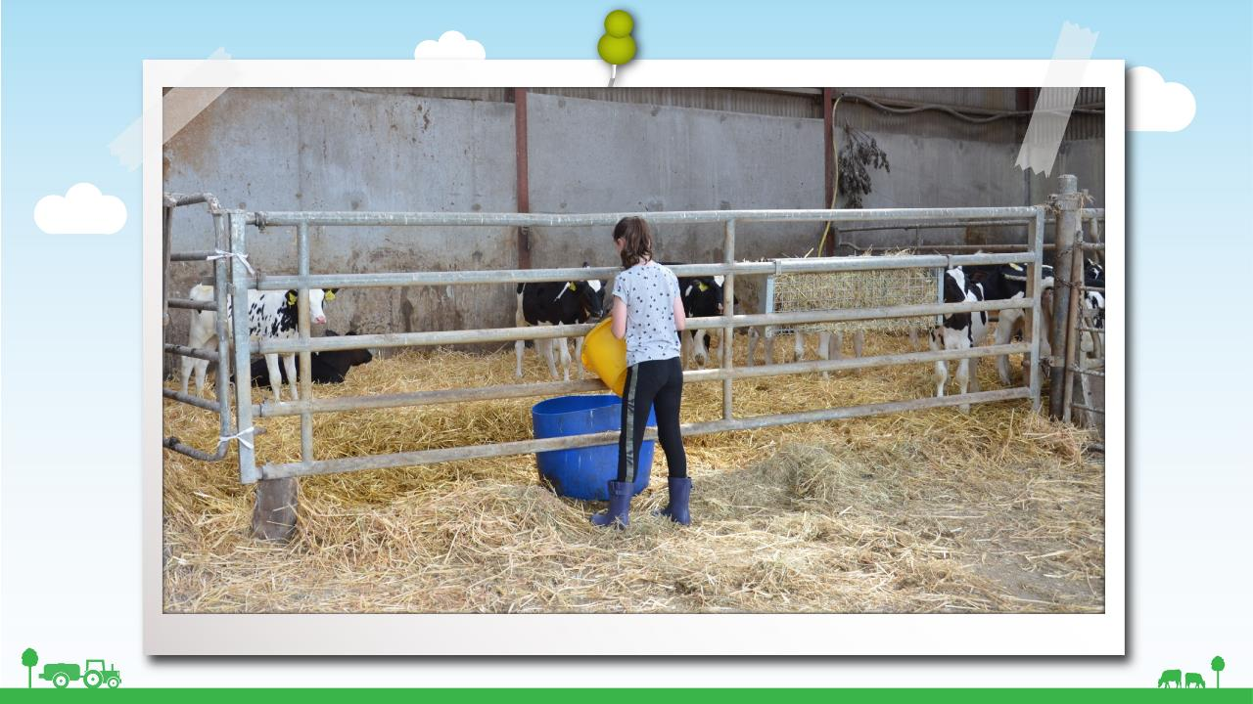
Notes:
Things you can do cont

Slide 21
Notes:
It is great fun to play outdoors when the weather is good but what should the boys and girls be careful to do when playing in the sun?
Yes, you should always
Wear a T-shirt
Wear a sun hat
Play in the shade between 11am – 3pm
Apply a high protection sunscreen to exposed skin. It is recommended to use a minimum of SPF 30 but to encourage SPF 50

Slide 22
Notes:
Hygiene
Remember there’s lots of germs on farms, they can be dirty places and you can get dirty if you help out on the farm.
What ever you’ve done on the farm whether it be feeding or petting the animals what must you remember to do?? (wash your hands)
When you go home today, please tell your parents about the things you have been told and remind everyone who lives on the farm about the different ways to stay safe.
Thank you everyone for listening, has anyone any questions?

Slide 23
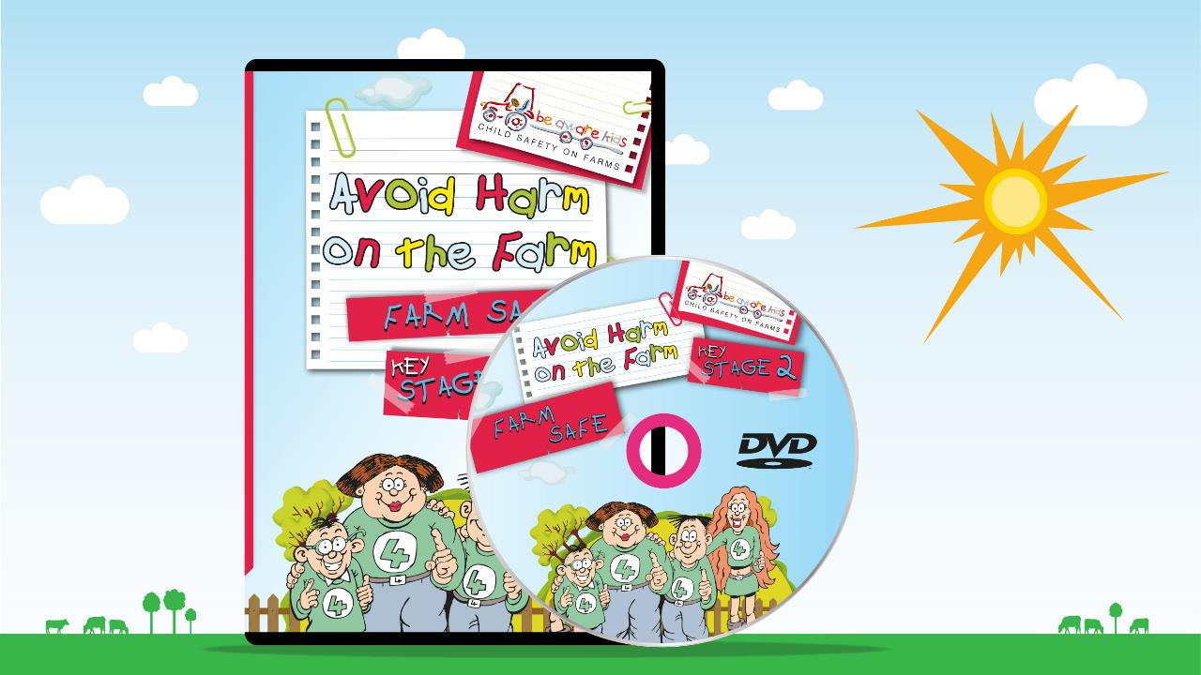
Notes:
That’s great, now were going to watch a short film where some children are going to tell you about the dangers on farms and you’ll get to see some of the things we’ve talked about.

